Slide 1
Two-photon Imaging Using tunable Spatial Correlations
Juan Sebastian Vargas
Advisor: Dra. Alejandra Valencia

Slide 2
Outline
Imaging and Two-photon Imaging
Spatial Correlations
Experiment
Theory
Experimental Procedure
Theory vs. Experiment
Time Table

Slide 3
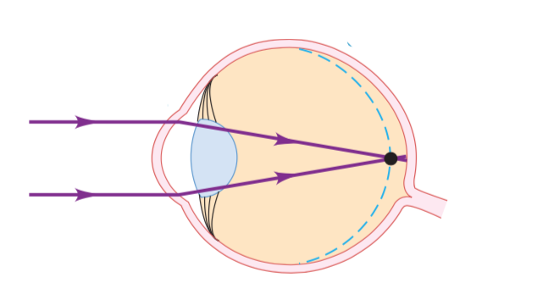
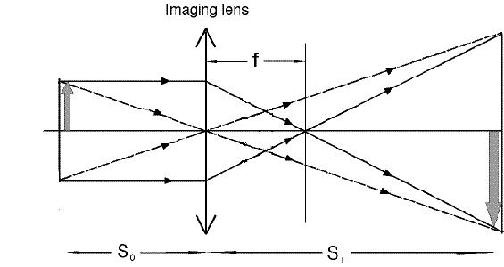
Imaging
Point-to-Point correspondence
Notes:
CUANDO SE USAN LOS LENTES PARA hacer imagenes definen plano imagen plano objeto

Slide 4
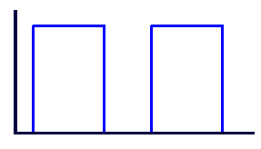



Two-Photon Imaging
D_{A}
S.C
X₂
X₂
D_{C}
C.C
X₂
S.C
X₂
Notes:
por que podemos recuperar la imagen? es necesario introducir la nocion de correlacion espacial

Slide 5
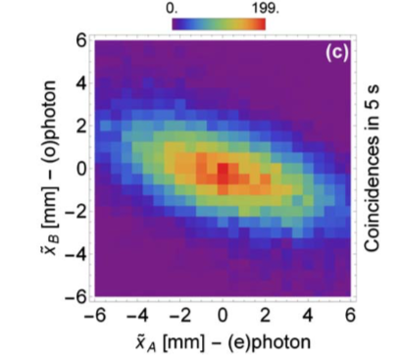
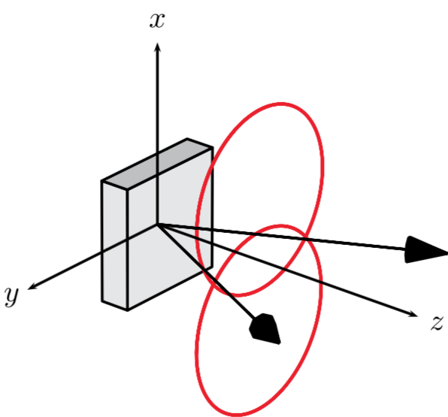
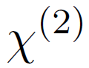
Spatial Correlations
x
D_{B}
y
x
D_{A}
y
SPDC
(spontaneous parametric down conversion)
Signal(B)
Pump
Idler(A)
Notes:
generacion de pares cuyas posiciones estan relacionadas entre si, es decir, para un x1 dado existen unos x2 con mayor probabilidad.

Slide 6
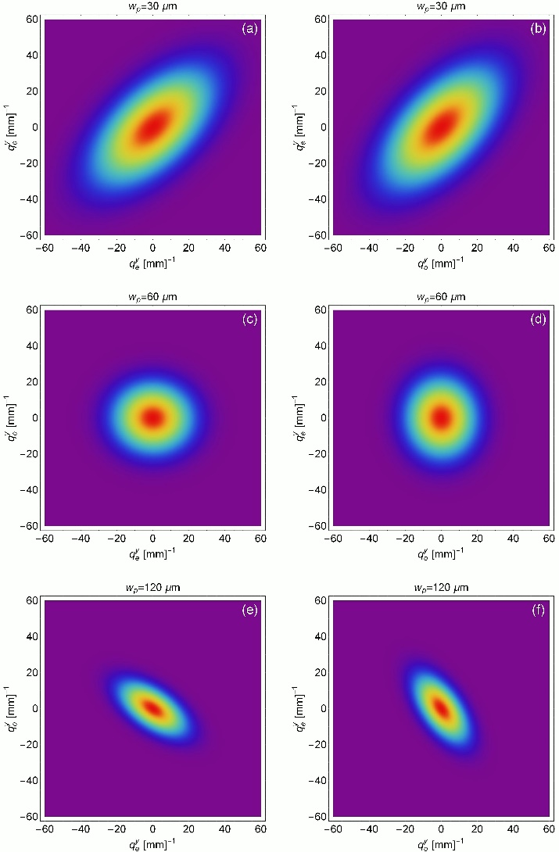
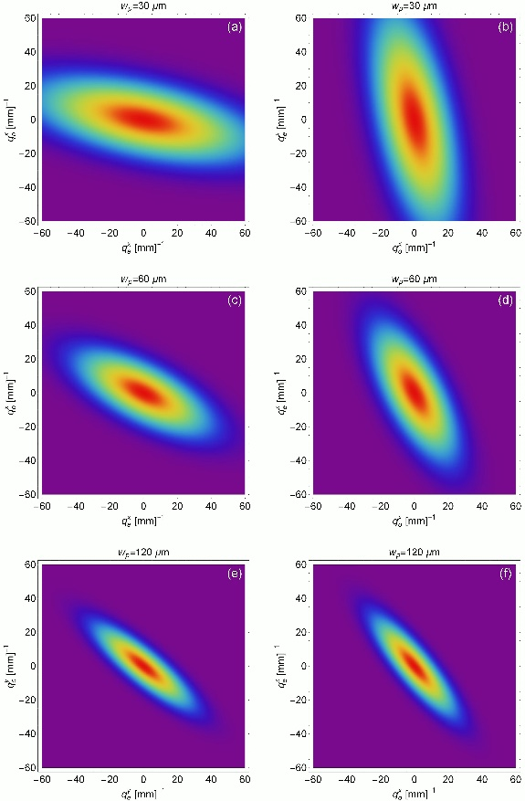
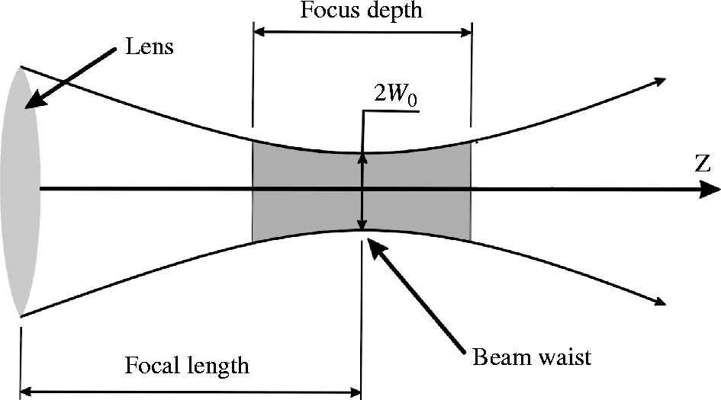
Tunable Spatial Correlations
SPDC
(spontaneous parametric down conversion)
x-direction
Signal(B)
y-direction
Pump
Idler(A)
Notes:
como medimos estas correlaciones?

Slide 7
Experimental Setup for Correlations
x
D_{B}
y
f
f
y
D_{A}
x
Notes:
Experimental setup for obtaining the spatial correlations

Slide 8
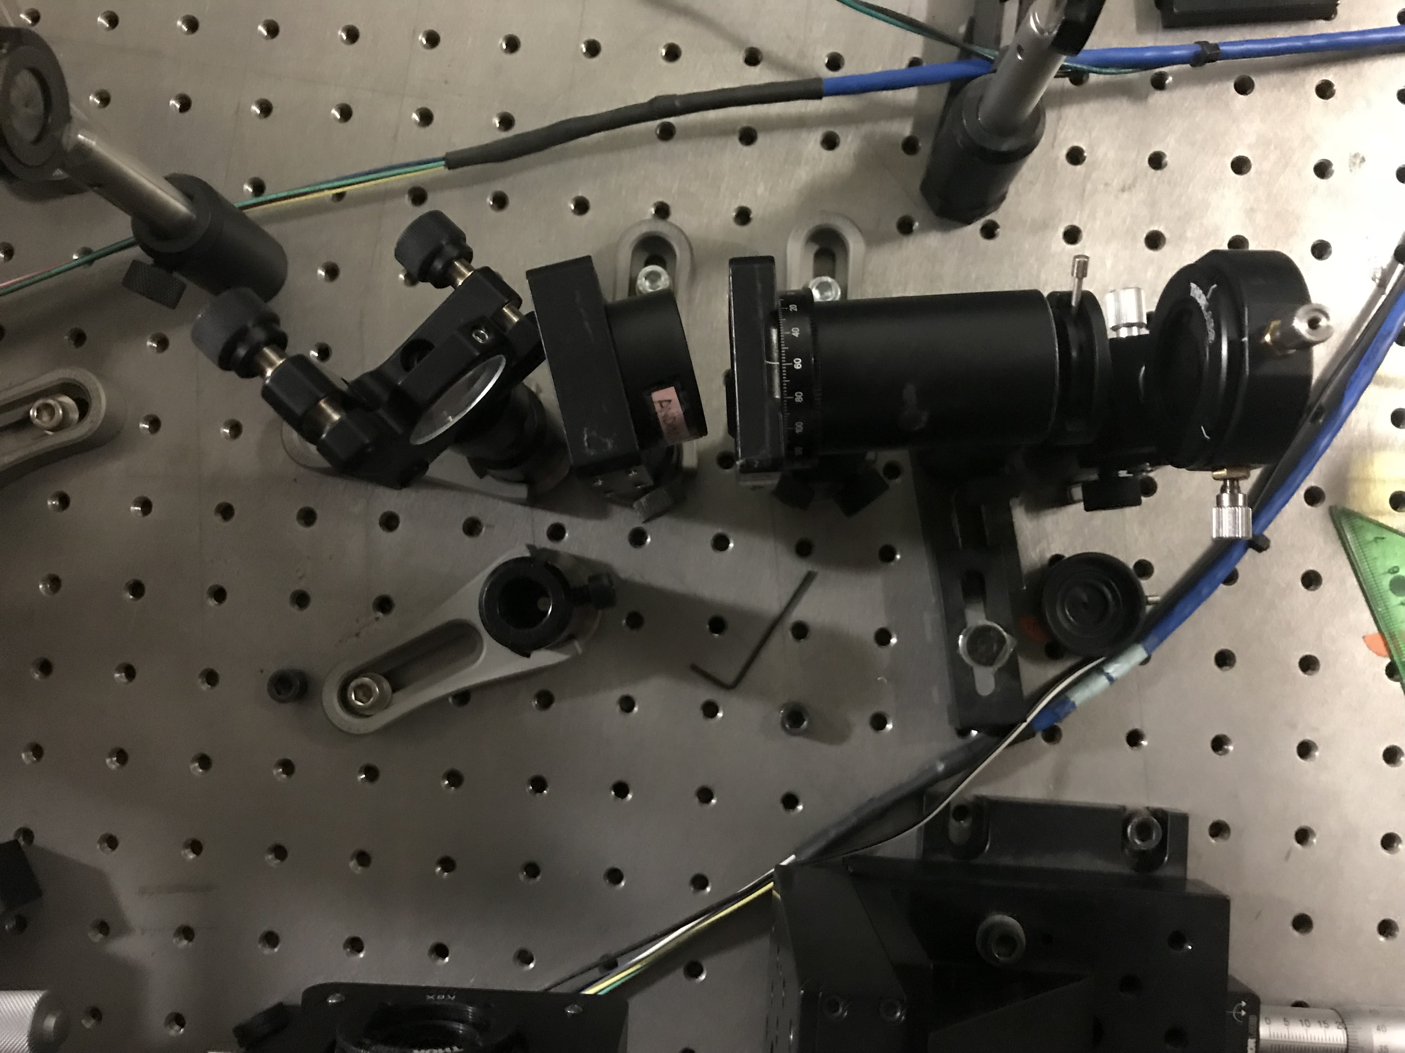
Experiment
x
D_{B}
y
D_{A}
y
x
Notes:
Debo ser capas de ver el ghost y ver las correlaciones !!!!

Slide 9
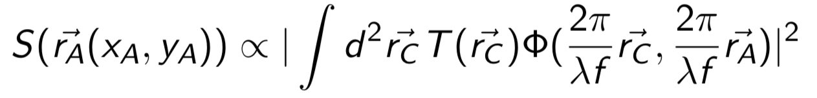

Theory
Numerical Correlations
A
B
B
A
A
A
Notes:
Setup del Ghost , titulo imagenes

Slide 10
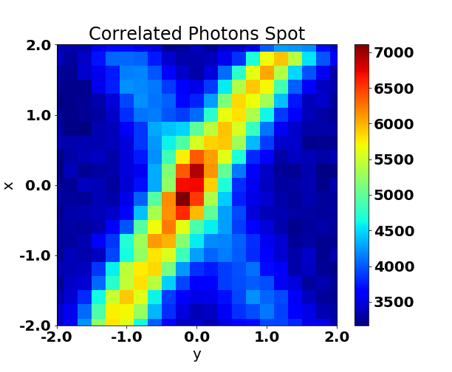
Experimental Procedure 1.Finding the correlated photons
B(mm)
Photon Counts 1seg
A(mm)

Slide 11
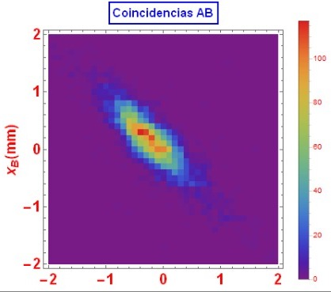
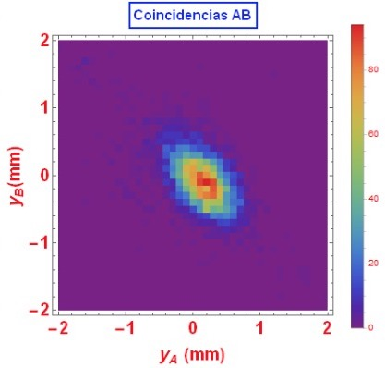
Experimental Procedure 2. Measuring Spatial Correlations
x_{B}(mm)
y_{B}(mm)
x_{A}(mm)
y_{A}(mm)
Notes:
Referencias imagenes de el grupo. Diciendolo.

Slide 12
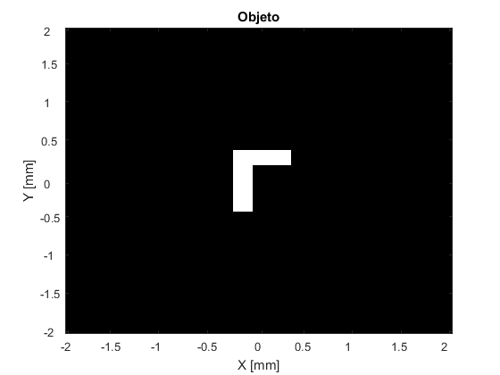
Experimental Procedure 3. Mask Alignment: Used Masks

Slide 13
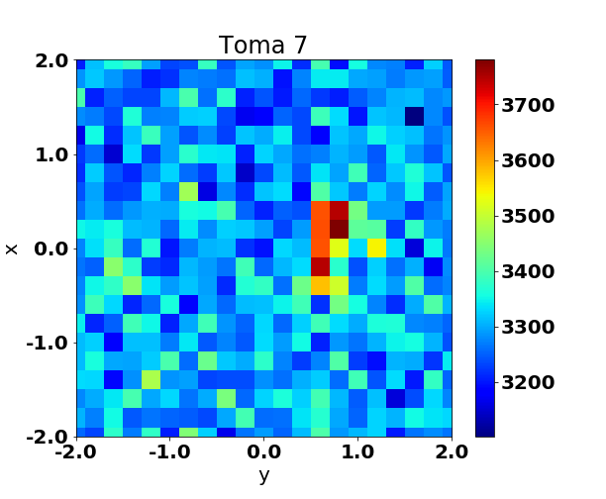
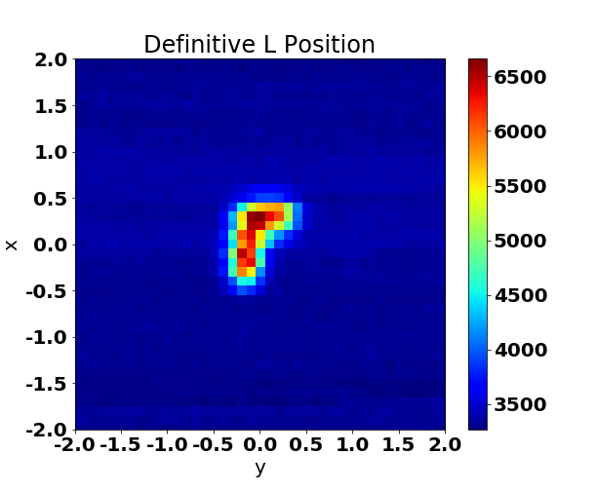
Experimental Procedure 3. Mask Alignment
_{B}(mm)
_{B}(mm)
Photon Counts 1seg (step=0.2mm)
Photon Counts 30seg (step=0.1mm)
_{B} (mm)
_{B}(mm)

Slide 14
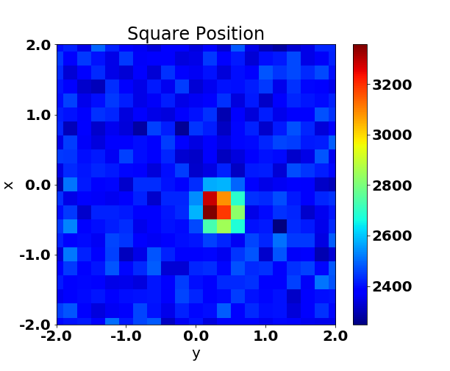
Experimental Procedure 3. Mask Alignment
_{B} (mm)
Photon Counts 1seg (step=0.2mm)
_{B}(mm)

Slide 15
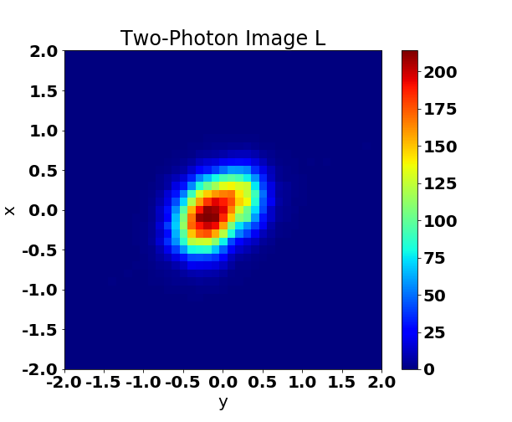
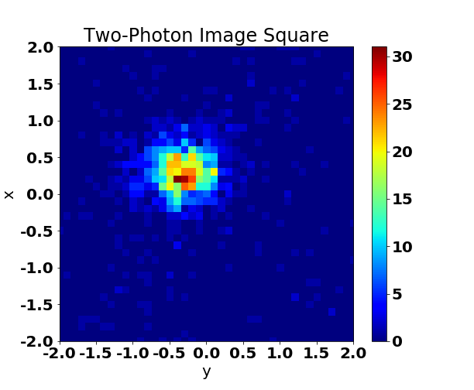
Experimental Procedure 4. Two-photon Imaging
_{A}(mm)
_{A}(mm)
Photon Coincidences 30seg (step=0.1mm)
Photon Coincidences 30seg (step=0.1mm)
_{A}(mm)
_{A}(mm)
Notes:
EJES CON MAYOR INFORMACION, SIZE, UNIDADES. Ghost_Inter.png
Ghost_L.png

Slide 16
Theory vs. Experiment
x_{A}(mm)
Photon Coincidences 30seg (step=0.1mm)
x_{A}(mm)
y_{A}(mm)
y_{A}(mm)

Slide 17
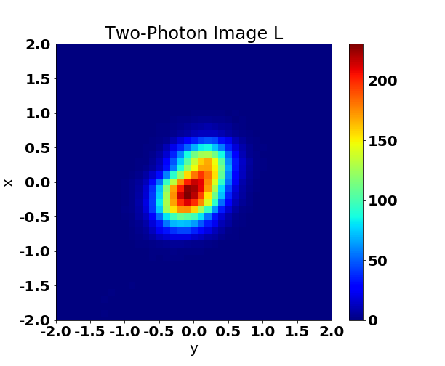
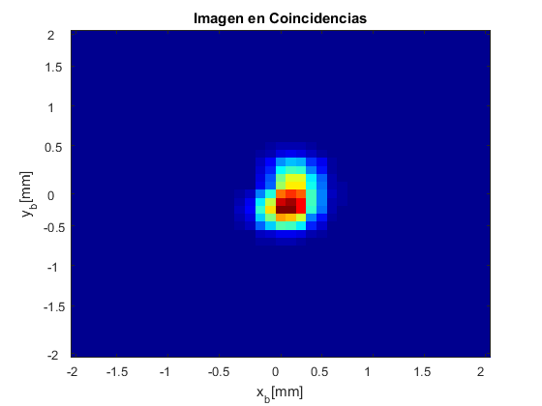
Theory vs. Experiment
x_{A}(mm)
Photon Coincidences 30seg (step=0.1mm)
x_{A}(mm)
y_{A}(mm)
y_{A}(mm)

Slide 18
Time Table
 | 1 | 2 | 3 | 4 | 5 | 6 | 7 | 8 | 9 | 10 | 11 | 12 | 13 | 14 | 15 | 16
T1 | X | X | X |  |  |  |  |  | X |  |  |  |  | X
T2 |  | X | X
T3 |  |  | X | X
T4 |  |  |  | X | X
T5 |  |  |  |  | X | X
T6 |  |  |  |  |  | X | X
T7 |  |  |  |  |  |  | X | X | X
T8 |  |  |  |  |  |  |  |  | X | X |  | X | X
T9 |  |  |  |  |  |  |  |  |  | X | X |  |  | X
T10 |  |  |  |  | X |  |  |  | X |  |  |  |  |  | X | X
T11 |  |  |  |  |  |  |  | X
T12 |  |  |  |  |  | X |  |  |  | X
Theoretical and Practical Background
T1. Bibliography Review
T2. Laboratory Equipment
T3. Writing First version, Theoretical Aspects
SPDC Source
T4. Understanding SPDC process
T5. Learning how to control the pump waist
T6. Measuring Different Spatial Correlations
Lens less Two-photon Imaging
T7. Experimental Setup
Data Acquisition and Analysis
T8. Data Acquisition
T9. Data Analysis
Document and Presentations
T10. Document writing
T11. 30% presentation
T12. Quantum Optics Seminar presentation

Slide 19
Future Work
Special Thanks:
Quantum Optics Group
Omar Calderon
Daniel Urrego
Juan Andres U
Change pump waist
Measure new correlations
Two-photon Imaging with the used masks
Compare Results

